Slide 1
Improving Patient Outcomes through Predictive Analytics: Predicting ICU Readmission Using NLP and AI Models.
Michigan Technological University
Andrea Wroblewski
Group 1
April 2024
Notes:
Hi, my name is Andrea Wroblewski. The title of my project is Improving Patient Outcomes through Predictive Analytics: Predicting ICU Readmission Using NLP and AI Models.

Slide 2
Goal
The goal of this project is to develop and evaluate a predictive analytics model utilizing machine learning and natural language processing (NLP) techniques to accurately identify patients at risk of ICU readmission within 30 days.
Notes:
This project aims to build a predictive model that can identify patients at high risk of ICU readmission within 30 days. By using both structured clinical data (like vital signs and demographics) and unstructured data from discharge summaries, I aimed to develop a hybrid AI model that supports early intervention, improves decision-making, and ultimately enhances patient outcomes.

Slide 3
Background
ICU readmissions occur in approximately 16% of cases within 30 days post-discharge, with significantly higher mortality rates (21–40%) compared to non-readmitted patients (3.6–8.4%). (Sheetrit, E. et al.,2023).
These readmissions increase healthcare costs, strain resources, and highlight the need for early detection strategies (Rojas et al., 2018).
Notes:
ICU readmissions are a major issue. Around 16% of patients are readmitted within 30 days of discharge, and their mortality rate is significantly higher: between 21 to 40 percent. In contrast, patients who aren’t readmitted have mortality rates closer to 3 to 8 percent. These readmissions increase hospital costs and strain resources, making accurate prediction incredibly valuable in the clinical setting.

Slide 4
Literature Review
Study / Model | Type | Key Findings
GBM (Rojas et al., 2018) | Structured Data | AUROC 0.76 using EHR features. Solid performance with traditional ML.
Discharge Notes (Sheetrit et al., 2023) | Unstructured Text | Text-based notes outperformed structured data, showing richer clinical signals.
Text-Based NLP Model (Orangi-Fard et al., 2022) | Unstructured Text | AUROC improved from 0.71 to 0.74 after feature selection (825 words) using SVM-RBF
BERTopic + LSTM (Chiu et al., 2024) | Unstructured Text | Leveraged topic modeling + LSTM to extract semantic patterns from notes.
Optimized XGBoost (González-Nóvoa et al., 2023) | Structured Data | Achieved AUROC 0.92, showing benefits of hyperparameter tuning.
ClinicalBERT (Alsentzer et al., 2019) | Unstructured Text (MIMIC) | Outperformed BioBERT and general BERT by capturing domain-specific context.
MedText (Lu et al., 2021) | Hybrid (Text + Knowledge Graph) | AUROC 0.825 by combining discharge summaries with UMLS knowledge graphs.
Notes:
This table summarizes key studies that applied machine learning and NLP models to predict ICU readmissions.
Starting with Rojas et al. (2018), they used structured EHR data with Gradient Boosting, achieving an AUROC of 0.76. This set a strong baseline using vitals, labs, and nursing assessments.
Sheetrit et al. (2023) found that discharge notes outperformed structured data, with ClinicalBERT yielding an AUROC of 0.752. This highlighted the untapped predictive value of unstructured text.
Orangi-Fard et al. (2022) showed that even with simple NLP techniques like Bag-of-Words and SVM, text alone could yield an AUROC of 0.74 after selecting just 825 top words.
Chiu et al. (2024) took this further using topic modeling and LSTM, capturing semantic themes and their sequences from notes to enhance prediction.
On the structured side, González-Nóvoa et al. (2023) achieved state-of-the-art performance with an AUROC of 0.92 using optimized XGBoost and SHAP for interpretability.
Alsentzer et al. (2019) introduced ClinicalBERT, pretrained on 2 million MIMIC-III notes. It outperformed general BERT models for multiple clinical NLP tasks.
Finally, Lu et al. (2021) introduced MedText, a hybrid model combining discharge summaries with medical knowledge graphs via Multiview graph convolution. It achieved an AUROC of 0.825, showing how structured semantics improve text-based models.
Overall, we see that unstructured data especially when combined with knowledge-enhanced architectures, can significantly improve ICU readmission predictions.

Slide 5
Data Sets
MIMIC-IV
Version: 2.2
https://physionet.org/content/mimiciv/2.2/
MIMIC-IV-Note: Deidentified free-text clinical notes
Version: 2.2
https://physionet.org/content/mimic-iv-note/2.2/
Notes:
I used two main datasets from the PhysioNet repository: MIMIC-IV, which includes ICU patient data, and MIMIC-IV-Note, which contains de-identified discharge summaries. Structured data included age, gender, lab results, diagnosis codes, and ICU stay details. Unstructured data was processed using ClinicalBERT to transform free-text discharge notes into over 700 numerical features.

Slide 6
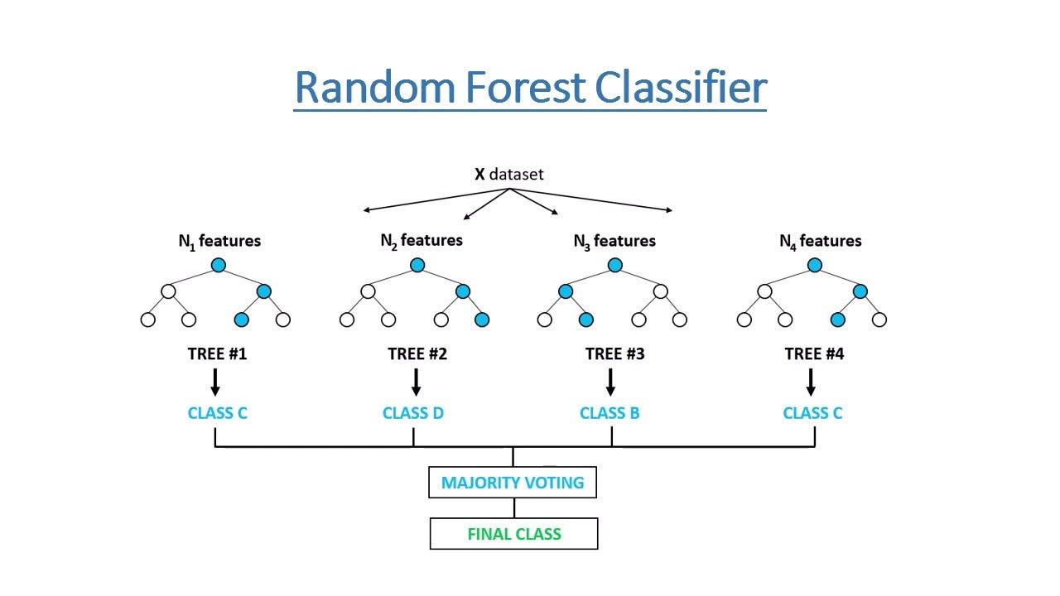
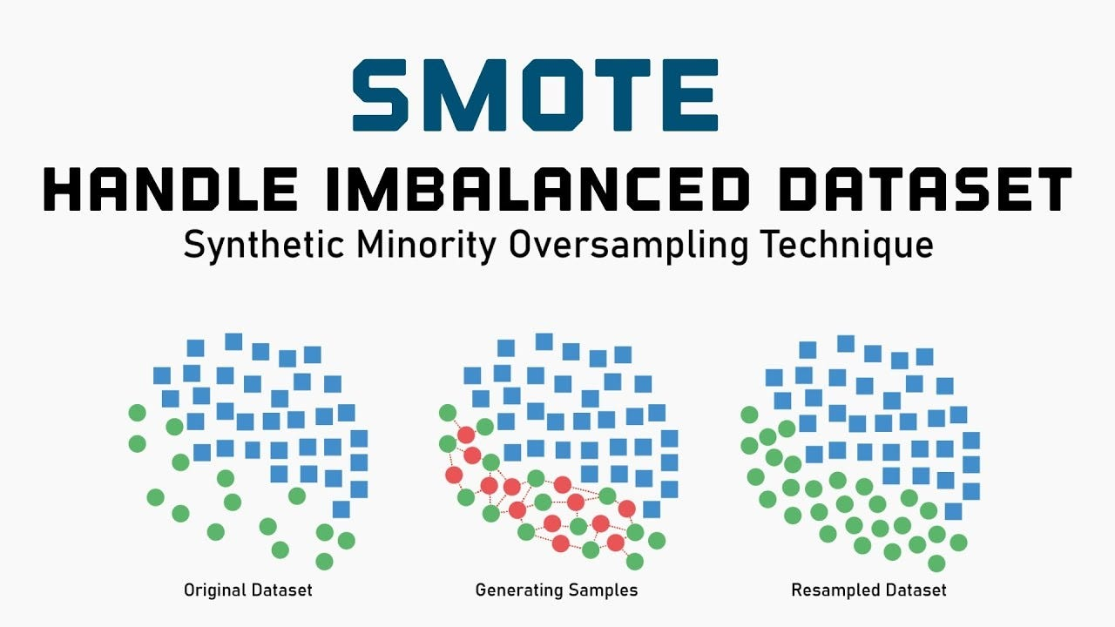
Models Used
Random Forest Classifier
SMOTE
Synthetic Minority Over-sampling Technique
XGBoost Classifier
Extreme Gradient Boosting
ClinicalBERT
Bidirectional Encoder Representations from Transformers
Notes:
I used several machine learning models throughout the project.
First, Random Forest served as my baseline for both the structured data alone and the combined (structured and unstructured section).
I applied SMOTE to address class imbalance, especially since readmitted patients were the minority.
SMOTE, or Synthetic Minority Over-sampling Technique, is used to fix class imbalance by generating new, synthetic examples of the minority class—in this case, patients who were readmitted to the ICU.
It selects a real patient from the minority class (e.g., someone who was readmitted).
Then it finds that patient's nearest neighbors in the dataset.
It randomly selects one of the neighbors.
Instead of copying, it creates a new synthetic sample somewhere between the original and the neighbor by interpolating their features.
I then used XGBoost — a high-performance model that allowed for fine-tuning and boosting performance.
It’s a powerful machine learning algorithm that builds an ensemble of decision trees, where each new tree tries to correct the errors of the previous ones.
It starts with a simple model, like one small decision tree.
Then it builds new trees one by one, each trying to fix the mistakes made by the earlier ones.
It combines all the trees to make the final prediction—like voting, but weighted.
It learns from errors using a method called gradient boosting (based on loss minimization).
Finally, I incorporated ClinicalBERT, which uses a transformer-based NLP architecture, to embed discharge summaries into meaningful features.
The strongest results came from XGBoost combined with SMOTE and ClinicalBERT.
Understands medical language better than regular BERT.
Trained specifically on discharge summaries, progress notes, and clinical reports.
I used ClinicalBERT to turn discharge summaries into numerical vectors, called embeddings. These embeddings captured the context and meaning of the text and were combined with structured data—like age and length of stay—to create a more complete input for my models.

Slide 7
Code: Libraries Used
# Data manipulation and OS interaction
import numpy as np # Numerical operations
import pandas as pd # Data handling
import os # Operating system interactions
# Visualization
import matplotlib.pyplot as plt # Plotting graphs
import seaborn as sns
from sklearn.metrics import (
classification_report, # Precision, recall, f1-score
roc_auc_score, # AUC for ROC
roc_curve,
confusion_matrix,
ConfusionMatrixDisplay # Display confusion matrix
)
# Machine learning models and tuning
from sklearn.ensemble import RandomForestClassifier # Random Forest model
from xgboost import XGBClassifier # XGBoost classifier
from sklearn.model_selection import train_test_split, RandomizedSearchCV # Splitting & tuning
# NLP & deep learning (for ClinicalBERT embeddings later)
import torch
from transformers import AutoTokenizer, AutoModel
from tqdm import tqdm # Progress bar
# Handling class imbalance
from imblearn.over_sampling import SMOTE # Synthetic Minority Over-sampling Technique
Notes:
First we need to import the necessary libraries.
I’ll walk through a few key ones:
SMOTE from imblearn is used to handle class imbalance by generating synthetic examples of the minority class.
Matplotlib and NumPy are used for plotting and numerical operations
Pandas is essential for data manipulation and analysis.
From sklearn.metrics, we import tools to evaluate model performance, such as the classification report, ROC AUC, and the confusion matrix.
For models, we use RandomForestClassifier from sklearn, and we split the dataset with train_test_split.
Torch is used to support our deep learning operations, particularly for ClinicalBERT, which we bring in using Hugging Face’s AutoTokenizer and AutoModel.
To improve model performance, we include RandomizedSearchCV for hyperparameter tuning.
Finally, we import XGBClassifier from the xgboost library, which builds an ensemble of decision trees and often provides strong performance on structured data.
Together, These imports enable us to build, tune, and evaluate a robust model for predicting ICU readmissions using structured and unstructured data.

Slide 8
Code: Structured Data
patients_path = "S:/Downloads/mimic-iv-2.2/mimic-iv-2.2/hosp/patients.csv.gz" #Patient demographic Info
icustays_path = "S:/Downloads/mimic-iv-2.2/mimic-iv-2.2/icu/icustays.csv.gz" #ICU admission and discharge record
diagnoses_path = "S:/Downloads/mimic-iv-2.2/mimic-iv-2.2/hosp/diagnoses_icd.csv.gz" #ICD diagnosis code
df_patients = pd.read_csv(patients_path)
df_icustays = pd.read_csv(icustays_path)
diagnosis_chunks = [] #Temporary list to hold filtered chunks
target_subject_ids = set(df_patients['subject_id'].unique()) #Keep only relevant patient
#Process diagnoses.csv in chunks of 50,000 rows
for chunk in pd.read_csv(diagnoses_path, chunksize=50000):
filtered_chunk = chunk[chunk['subject_id'].isin(target_subject_ids)]
diagnosis_chunks.append(filtered_chunk) #Append each filtered chunk
#Combine all chunks into one DataFrame
df_diagnoses = pd.concat(diagnosis_chunks, ignore_index=True)
Notes:
In this step, I loaded and prepared the core structured data from the MIMIC-IV dataset. I used three key files:
Patient demographics
ICU stays
Diagnoses Because the diagnosis file is very large, I loaded it in smaller chunks of 50,000 rows to avoid memory issues. I then filtered each chunk to include only patients found in the patients.csv file, using subject_id as the key. After filtering, I combined the chunks into a final DataFrame.

Slide 9
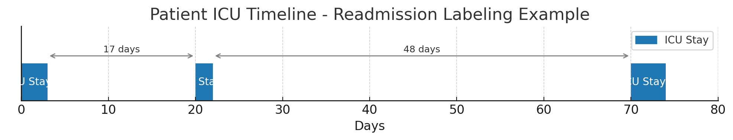
Code: Structured Data
df_icustays['intime'] = pd.to_datetime(df_icustays['intime'])
df_icustays['outtime'] = pd.to_datetime(df_icustays['outtime'])
df_icustays = df_icustays.sort_values(by=['subject_id', 'intime']).reset_index(drop=True)
readmission_labels = []
"""Empty list to hold readmission data
0 = Not Readmitted
1= Readmitted to ICU within 30 days
"""
# Loop through ICU stays grouped by patient
for subject_id, stays in df_icustays.groupby('subject_id'): #A datafram that has patient ICU stays
stays = stays.sort_values(by='intime').reset_index(drop=True)
readmitted = [0] * len(stays) #List of 0 and 1 for ICU readmissionc
for i in range(len(stays) - 1):
delta = (stays.loc[i + 1, 'intime'] - stays.loc[i, 'outtime']).days #Calculates number of days between discharge and the next admission
if 0 < delta <= 30: #If patient was not readmitted to the ICU in 30 Days
readmitted[i] = 1 #If reamitted 1
readmission_labels.extend(readmitted) #Adds readmitted data to list
df_icustays = df_icustays.iloc[:len(readmission_labels)] #Data frame only has as many rows as labels
df_icustays['readmitted'] = readmission_labels #Adds reamitted colum to ICU stays data set
Notes:
In this part of the project, I converted the ICU admission and discharge times from strings to actual datetime objects using Pandas. This allows me to calculate important clinical metrics like how long a patient stayed and whether they were readmitted within 30 days. I then sorted all ICU stays first by patient and then by their admission time to ensure everything was in the correct sequence. This is critical for identifying patterns in readmission and for generating accurate labels later on.
This timeline represents a single patient’s ICU stays.
The first ICU stay ends at day 3. The second stay begins on day 20, which is within 30 days, so it’s labeled as a readmission.
The third stay happens at day 70, which is too far from the previous stay to count as a readmission. This logic is applied to each patient to create the target labels that my model predicts.
This code defines which ICU stays count as readmissions. First, I looped through each patient’s ICU stays, sorted by admission time. Then, I compared each stay’s discharge time to the next stay’s admission time. If the gap was less than or equal to 30 days, I marked that stay as a readmission. I stored this information in a new column called readmitted, with 0 meaning no readmission and 1 meaning the patient was readmitted within 30 days. This label became the target variable for my machine learning models

Slide 10
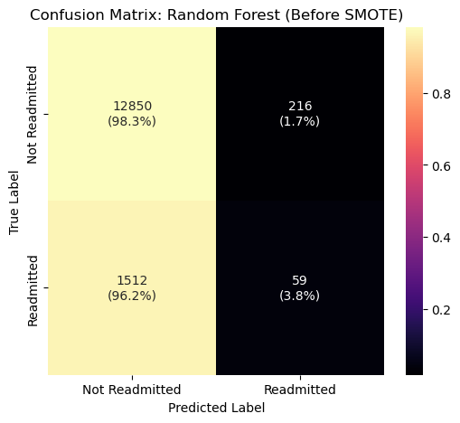
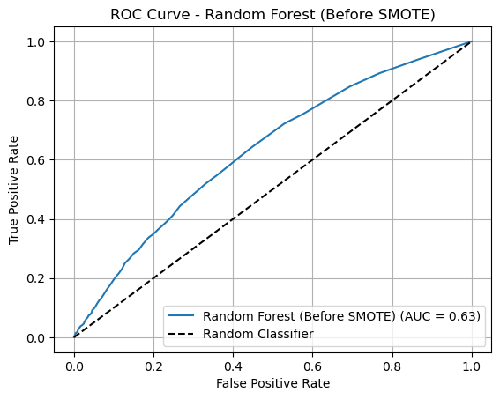
Structured Data: Random Forest Pre-SMOTE
Notes:
This slide shows the performance of the Random Forest model trained only on unbalanced structured data, without SMOTE. As you can see in the confusion matrix, the model correctly identified over 98% of non-readmitted patients. However, it failed to catch most of the readmitted cases (with only 3.8% correctly predicted). This imbalance leads to a very low recall (4%) for the positive class, which is dangerous in a clinical setting because we’re missing the patients who are actually at risk. The AUC is 0.63, which is only slightly better than random guessing.

Slide 11
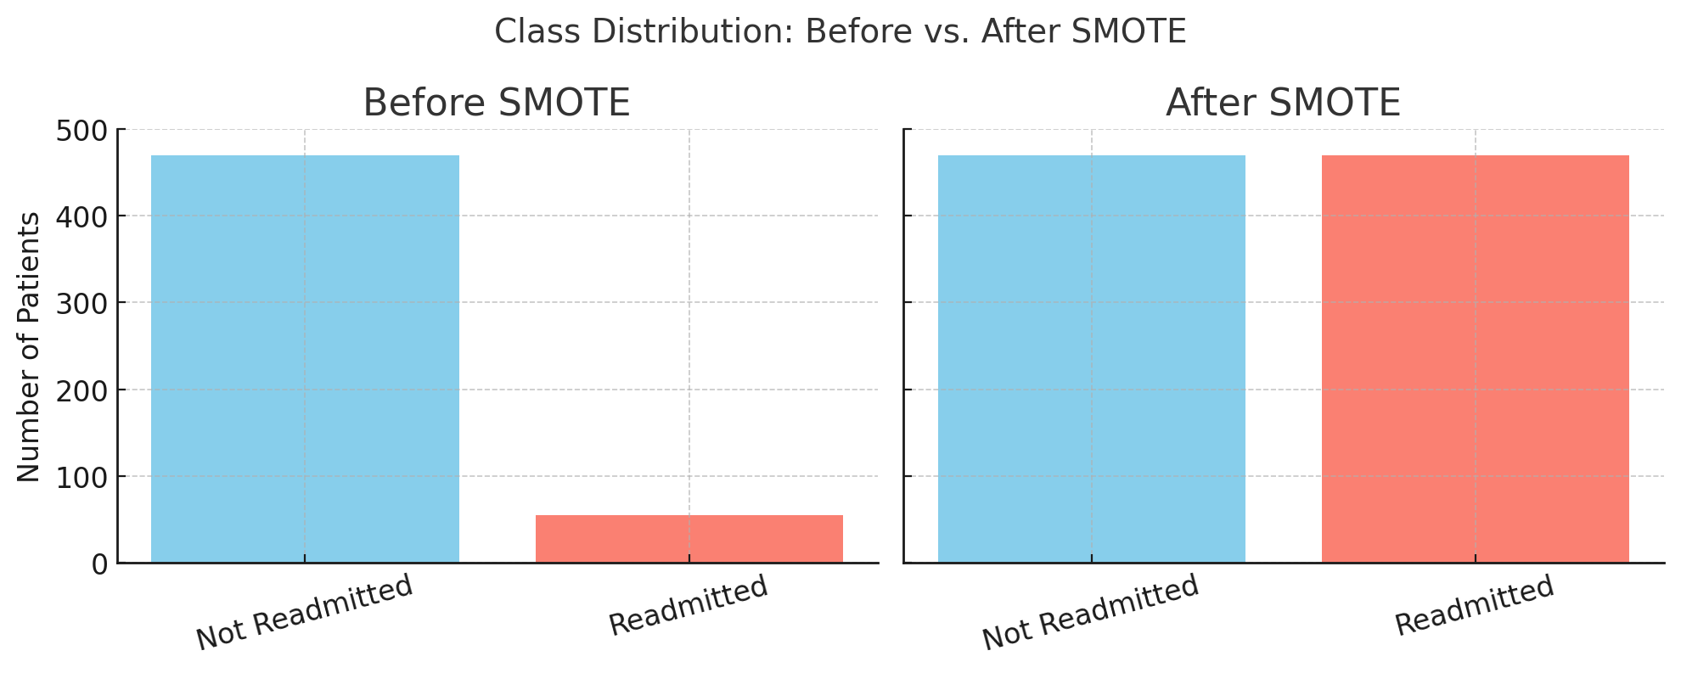
Code: Structured Data
#Apply SMOTE to Balance Classes
smote = SMOTE(random_state=42)
# Apply SMOTE only on training data to prevent data leakage
X_resampled, y_resampled = smote.fit_resample(X_train, y_train)
Notes:
The original dataset was highly imbalanced, with far fewer ICU readmissions compared to non-readmissions. To correct this, I used SMOTE, which generates synthetic samples for the minority class. I applied SMOTE only to the training data, this ensures that the test set remains untouched for proper evaluation. This allowed the model to better learn patterns associated with readmissions and significantly improved recall.

Slide 12
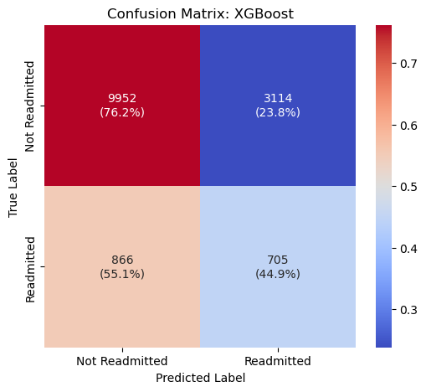
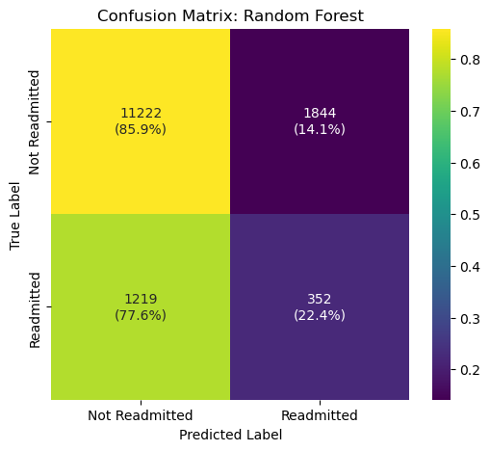
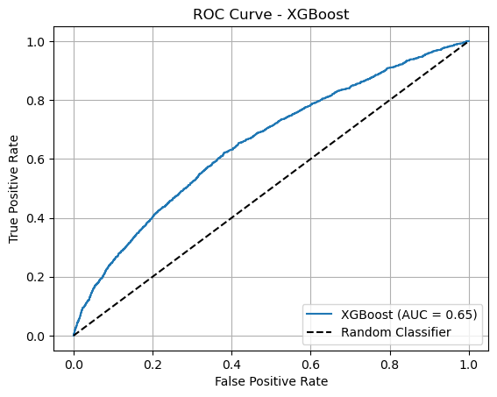
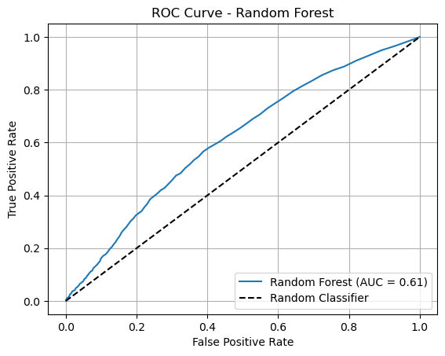
Results: Structured Data after SMOTE
Notes:
This slide compares two models: Random Forest and XGBoost, after SMOTE.
Random Forest model:
It correctly predicted most non-readmissions but only caught 22.4% of actual readmitted patients.
The ROC curve shows an AUC of 0.61, which is better than chance but still limited in sensitivity.
XGBoost:
It improved recall for readmitted patients to 44.9%, almost double what Random Forest achieved.
The ROC curve shows a slightly better AUC of 0.65.
So even though both models still miss some readmissions, XGBoost is more sensitive and provides better predictive value after SMOTE.

Slide 13
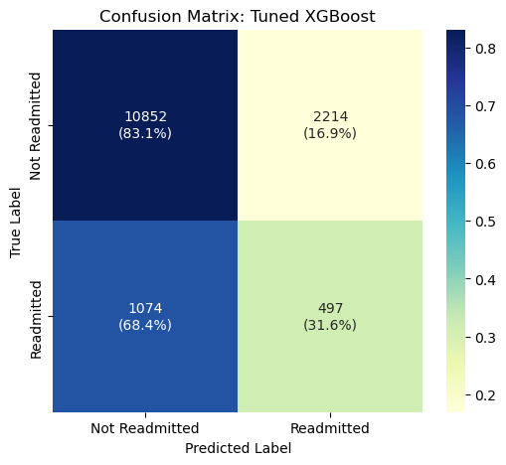
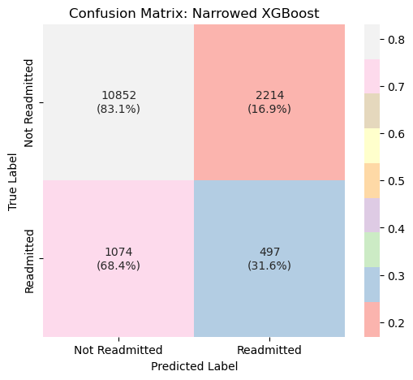
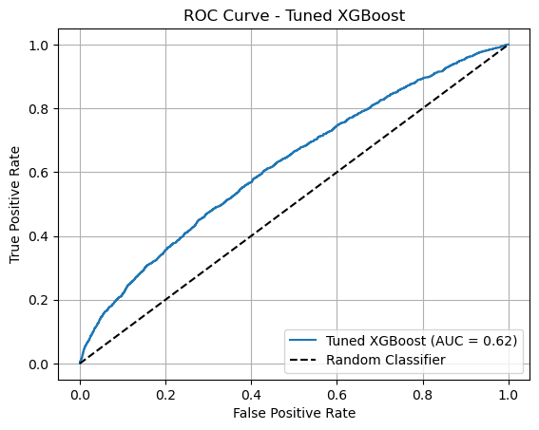
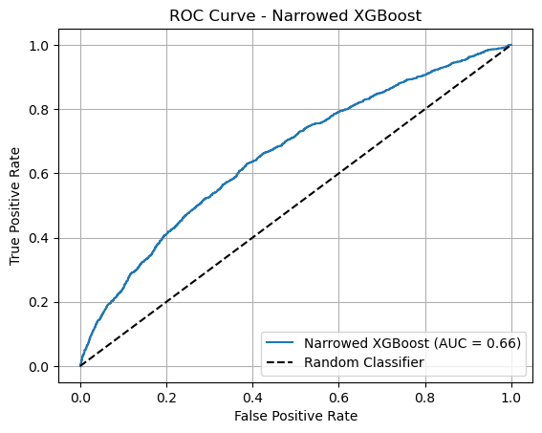
Results: Structured Data
Notes:
This slide compares two variations of the XGBoost model: a general tuned version and a narrowed version optimized for recall
Tuned XGBoost:
Correctly identifies about 31.6% of readmitted patients.
AUC-ROC is 0.62, which is a moderate improvement over the baseline models.
Still struggles with many false negatives, which means real readmissions are being missed.
Narrowed XGBoost: where the hyperparameter tuning was focused specifically on improving recall.
It achieves the same recall of 31.6%, but the ROC curve shows a slight gain with an AUC of 0.66.
This makes it slightly better at distinguishing readmitted vs. non-readmitted patients.
Both models made the exact same predictions in this run, but the narrowed search seems more consistent and generalizable based on how we tuned it specifically for the readmission class

Slide 14
Code: Unstructured Data
#Load the compressed discharge notes file
df_raw = pd.read_csv(
r"S:\Downloads\mimic-iv-note-deidentified-free-text-clinical-notes-2.2\note\discharge.csv.gz",
compression='gzip'
)
# Preview the data
print("Raw rows loaded:", len(df_raw))
print("Unique note types:", df_raw['note_type'].unique())
print(df_raw.head())
# Filter for Discharge Summaries
df_notes = df_raw[df_raw['note_type'] == 'DS']
# Keep only necessary columns
df_notes = df_notes[['hadm_id', 'text']].dropna()
df_notes = df_notes.drop_duplicates(subset='hadm_id')
df_notes = df_notes[df_notes['text'].str.strip() != ""].reset_index(drop=True)
#Check
print("Cleaned discharge summaries:", len(df_notes))
print(df_notes.head())
Notes:
This step focuses on extracting unstructured clinical notes from the MIMIC-IV dataset. I loaded the full set of notes, then filtered it to include only Discharge Summaries. To ensure clean input for ClinicalBERT, I removed any rows that had missing or empty text, and kept only one note per hospital admission using the hadm_id.

Slide 15
Code: Unstructured Data
tokenizer = AutoTokenizer.from_pretrained("emilyalsentzer/Bio_ClinicalBERT")
model = AutoModel.from_pretrained("emilyalsentzer/Bio_ClinicalBERT")
# Define embedding function
def embed_text_bert(texts, tokenizer, model, device='cpu', max_length=512):
embeddings = []
model.to(device)
model.eval()
with torch.no_grad():
for text in tqdm(texts, desc="Embedding discharge summaries"):
inputs = tokenizer(
text,
return_tensors="pt",
truncation=True,
padding="max_length",
max_length=max_length
)
inputs = {key: val.to(device) for key, val in inputs.items()}
outputs = model(**inputs)
cls_embedding = outputs.last_hidden_state[:, 0, :] # Take CLS token
embeddings.append(cls_embedding.cpu().numpy().squeeze())
return np.vstack(embeddings)
texts = df_notes['text'].iloc[:2500].tolist() # Discharge summaries
hadm_ids = df_notes['hadm_id'].iloc[:2500].tolist() # Corresponding hospital admission IDs
# Generate BERT Embeddings
bert_array = embed_text_bert(texts, tokenizer, model)
# Create DataFrame for embeddings
df_bert_embeddings = pd.DataFrame(
bert_array,
columns=[f"bert_feature_{i}" for i in range(bert_array.shape[1])]
)
# Attach hospital admission ID for merging with other clinical data later
df_bert_embeddings['hadm_id'] = hadm_ids
# Save embeddings for reuse
df_bert_embeddings.to_pickle("bert_embeddings.pkl")
print("BERT embeddings saved as bert_embeddings.pkl")
# Preview
print("ClinicalBERT embeddings shape:", df_bert_embeddings.shape)
print(df_bert_embeddings.head())
Notes:
In this step, I used the Bio_ClinicalBERT model from Hugging Face, which is pre-trained specifically on biomedical and discharge notes. I built a custom function that tokenizes each discharge summary, processes it through the model, and extracts the CLS tokens. I applied this to the first 2,500 notes to generate embeddings. These embeddings were stored in a DataFrame and indexed by hadm_id, which lets me combine them with the patient’s structured features later.

Slide 16
Code: Combining Datastes
# Load both DataFrames
df_structured = pd.read_pickle("structured_data.pkl")
df_bert_embeddings = pd.read_pickle("bert_embeddings.pkl")
# Merge on hadm_id
final_df = df_structured.merge(df_bert_embeddings, on='hadm_id', how='inner')
print("Final merged shape:", final_df.shape)
print(final_df.head())
Notes:
I had two separate datasets: one with structured patient information, and another with ClinicalBERT embeddings. I merged them using the hadm_id, which represents each hospital admission. The result was a combined dataset that includes both traditional clinical features and rich, contextual text features from the notes.

Slide 17
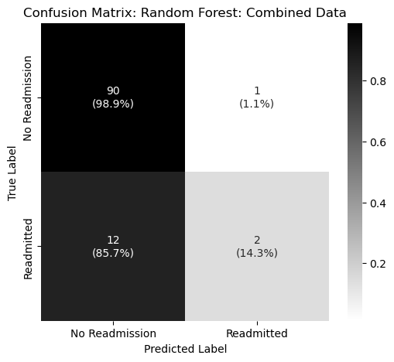
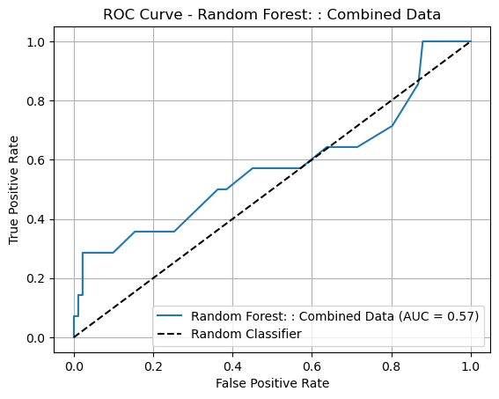
Results: Combined Before SMOTE
Notes:
This model combines both structured clinical data and unstructured discharge summary embeddings generated using ClinicalBERT.
From the confusion matrix, we can see:
The model predicted almost all non-readmitted cases correctly (98.9%).
However, it struggled with detecting readmissions—only 2 out of 14 were correctly identified (14.3% recall).
This highlights that even with richer input data, class imbalance still impacts model sensitivity.
ROC curve shows an AUC of 0.57, which is only slightly better than random guessing (0.50). So while this model benefits from additional features, more tuning or resampling (like SMOTE) would be needed to truly leverage the unstructured data.

Slide 18
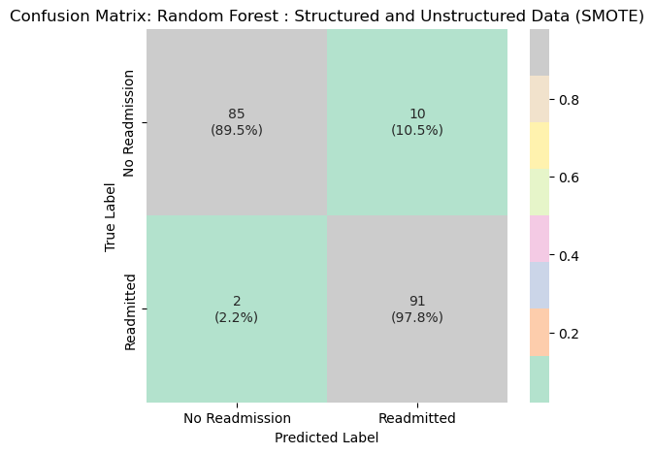
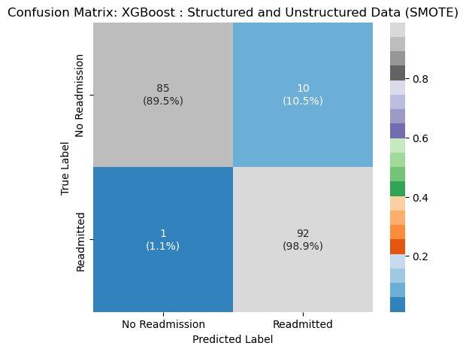
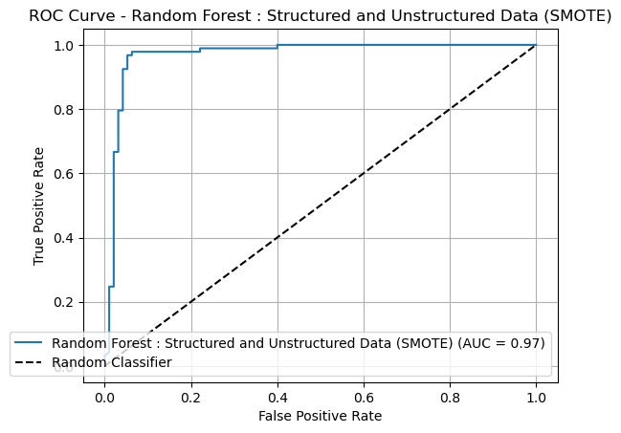
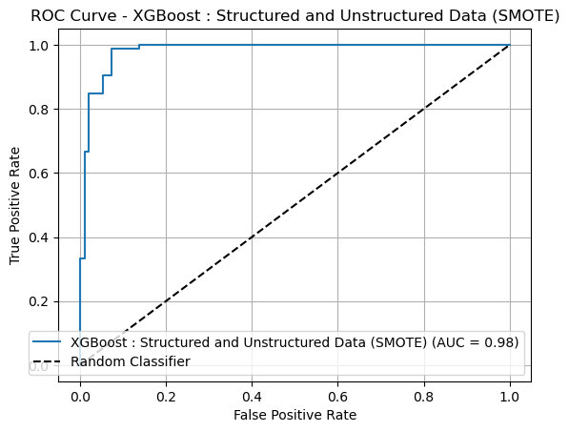
Results: Combined Post SMOTE
Notes:
Random Forest :
Confusion matrix:
91 out of 93 readmissions correctly identified (97.8% recall).
Only 2 false negatives. AUC-ROC = 0.97
XGBoost:
Confusion matrix:
92 of 93 readmissions correctly identified (98.9% recall).
Slightly fewer false positives as well.
AUC-ROC = 0.98
XGBoost handled the combined data most effectively, making it the top-performing model.

Slide 19
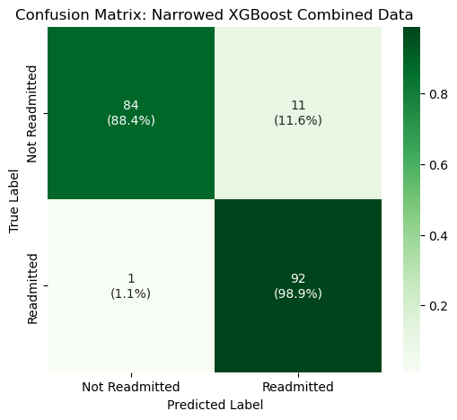
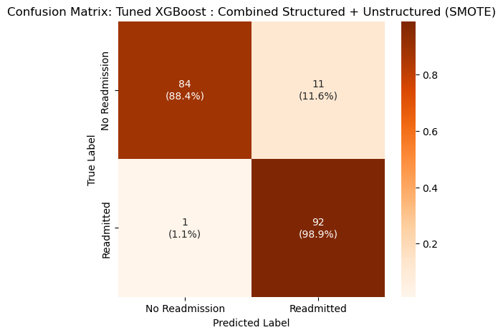
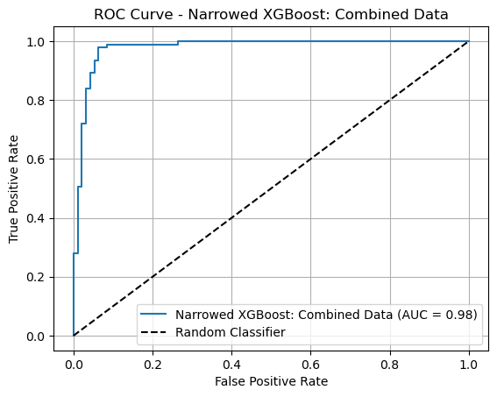
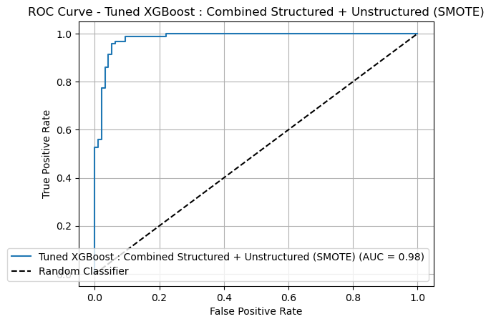
Results: Combined
Notes:
This slide compares the two most optimized models in my project: Tuned XGBoost and Narrowed XGBoost, both trained on the combined dataset and balanced with SMOTE.
Narrowed XGBoost:
Recall for readmitted class: 98.9%
Only 1 false negative out of 93 cases.
ROC AUC = 0.98
Strong performance with a focused hyperparameter grid.
Tuned XGBoost
Also achieved 98.9% recall for readmissions.
Confusion matrix is identical to Narrowed.
ROC AUC = 0.98 — identical to the narrowed model.
Although these models were tuned using different strategies, they ended up making identical predictions, achieving the highest recall and AUC in the entire project.
This confirms that the combination of:
Balanced training data (via SMOTE),
Rich discharge summary embeddings (via ClinicalBERT), and
Ensemble learning (via XGBoost)
delivers the most accurate and clinically meaningful results for predicting ICU readmissions.

Slide 20
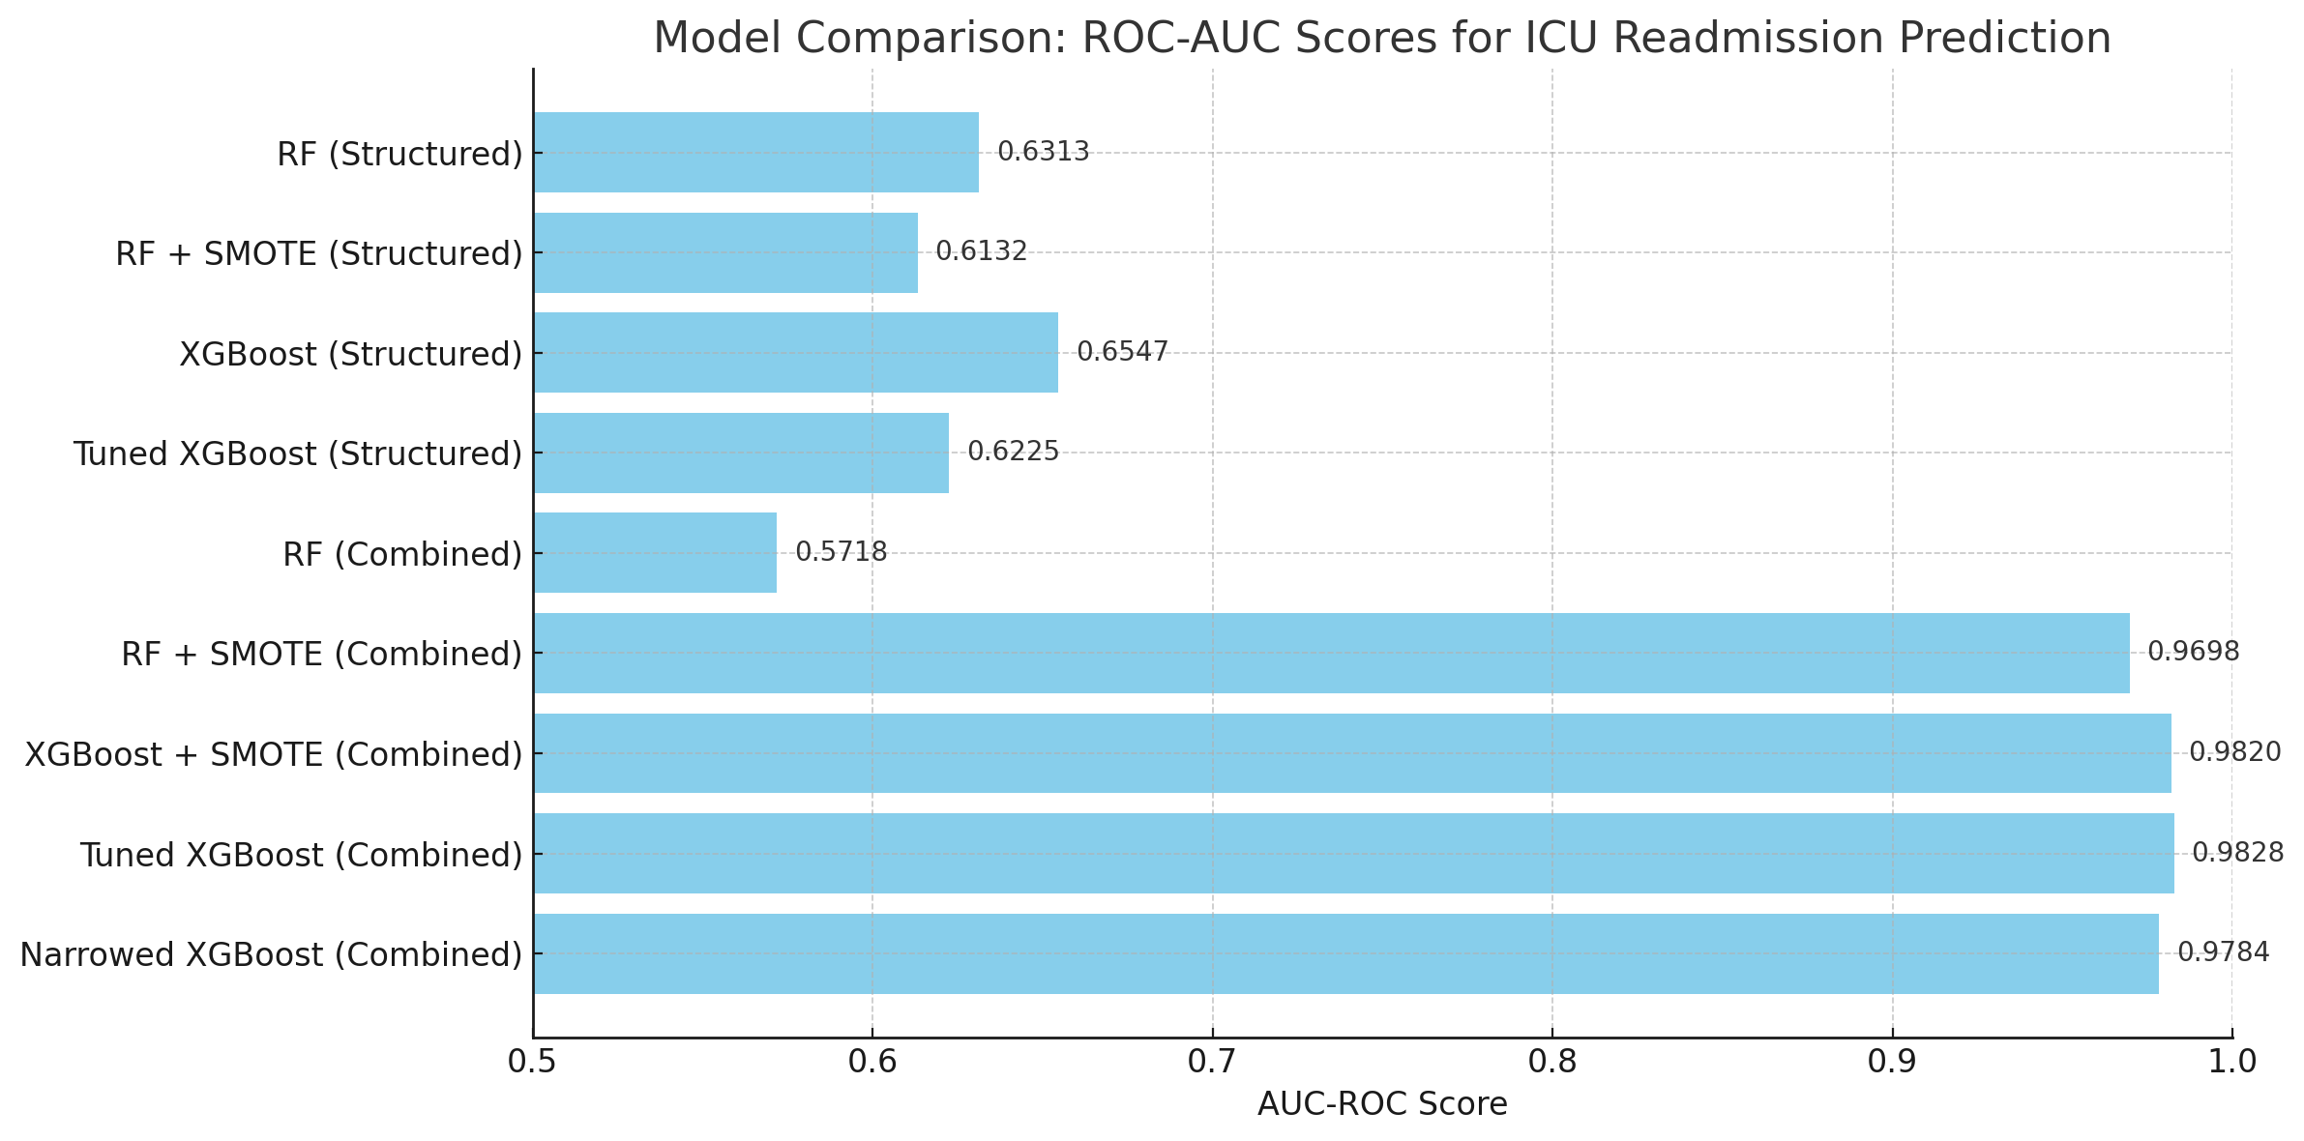
Conclusion
Merging structured data with ClinicalBERT-based unstructured text greatly enhances prediction.
Discharge summaries capture nuanced clinical risk factors missed in vitals/labs.
SMOTE addressed class imbalance, improving minority class recall.
Best performance: Narrowed XGBoost on combined data
AUROC = 0.98
Notes:
In conclusion, our best results came from combining structured EHR data with ClinicalBERT embeddings of discharge summaries. This hybrid approach, combined with class balancing through SMOTE and hyperparameter-tuned XGBoost, achieved an AUROC of 0.98. These results show the value of fusing rich clinical text with structured data and applying targeted ML techniques for early ICU readmission risk prediction

Slide 21
Conclusion
Limitations
Small sample size in final test evaluations may limit generalizability.
ClinicalBERT embeddings were only taken from the first 2500 notes (due to compute constraints).
SMOTE generates synthetic data, which may not fully capture real patient complexity.
Lack of external validation on non-MIMIC datasets.
Future Work
Scale ClinicalBERT embedding to full dataset for stronger representation.
Explore additional NLP models like BioBERT or Longformer for longer notes.
Incorporate time-series vitals and medications to enrich structured features.
Test models on real-time or external hospital data to assess generalizability.
Apply SHAP or LIME for explainability and model transparency in clinical settings.
Notes:
While the results were strong, the model was trained and tested on a relatively small slice of the data. Also, ClinicalBERT was only applied to the first 2500 notes for efficiency, so future work should focus on embedding the full set of notes. There’s also a lot of potential in using more advanced NLP models and incorporating time-based features like lab values and medications. Most importantly, testing these models in real-time environments or across multiple health systems will be key to proving clinical value.

Slide 22
References
Alsentzer, E., Murphy, J. R., Boag, W., Weng, W.-H., Jin, D., Naumann, T., & McDermott, M. B. A. (2019). Publicly available clinical BERT embeddings [Preprint]. arXiv. https://arxiv.org/abs/1904.03323
Chiu, C.-C., Wu, C.-M., Chien, T.-N., Kao, L.-J., & Li, C. (2024). Predicting ICU readmission from electronic health records via BERTopic with long short-term memory network approach. Journal of Clinical Medicine, 13(5503). https://doi.org/10.3390/jcm13185503
González-Nóvoa, J. A., Campanioni, S., Busto, L., Fariña, J., Rodríguez-Andina, J. J., Vila, D., Íñiguez, A., & Veiga, C. (2023). Improving intensive care unit early readmission prediction using optimized and explainable machine learning. International Journal of Environmental Research and Public Health, 20(3455). https://doi.org/10.3390/ijerph20043455
Johnson, A. E. W., Pollard, T. J., Shen, L., Li-wei Lehman, L., Feng, M., Ghassemi, M., Moody, B., Szolovits, P., Celi, L. A., & Mark, R. G. (2023). MIMIC-IV (version 2.2). PhysioNet. https://physionet.org/content/mimiciv/2.2/ https://doi.org/10.13026/a3wn-hq05
Johnson, A. E. W., Pollard, T. J., & Mark, R. G. (2023). MIMIC-IV-Note (version 2.2). PhysioNet. https://physionet.org/content/mimic-iv-note/2.2/ https://doi.org/10.13026/9e4v-qw40
Lu, Q., Nguyen, T. H., & Dou, D. (2021). Predicting patient readmission risk from medical text via knowledge graph enhanced multiview graph convolution. Proceedings of the 44th International ACM SIGIR Conference on Research and Development in Information Retrieval, 1989–1994. https://doi.org/10.1145/3404835.3463062
Orangi-Fard, N., Akhbardeh, A., & Sagreiya, H. (2022). Predictive model for ICU readmission based on discharge summaries using machine learning and natural language processing. Informatics, 9(1), 10. https://doi.org/10.3390/informatics9010010
Rojas, J. C., Carey, K. A., Edelson, D. P., Venable, L. R., Howell, M. D., & Churpek, M. M. (2018). Predicting intensive care unit readmission with machine learning using electronic health record data. Annals of the American Thoracic Society, 15(7), 846-853. https://doi.org/10.1513/AnnalsATS.201710-787OC
Sheetrit, E., Brief, M., & Elisha, O. (2023). Predicting unplanned readmissions in the intensive care unit: a multimodality valuation. Scientific reports, 13(1), 15426. https://doi.org/10.1038/s41598-023-42372-y

